Slide 1
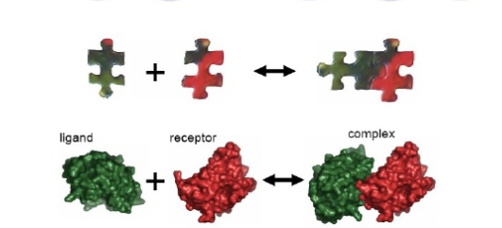
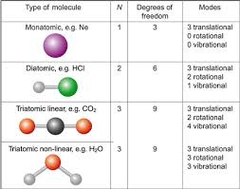
Degrees of freedom (DOF)
The flexibility of the protein/ligand is given
by the DOF assigned to their structure/atoms.
Low resolution Protein-protein Docking
Low flexibility (Rigid bodies) :
Intermolecular DOF
Displacement
Orientation
High resolution Protein-protein Docking
Conformational flexibility induced by protein binding need (in addition to inter-DOF) , to be described by intra-molecular DOF
Bigger DOF produces BIGGER data:
Focuse on probable regions that the ligand and protein will bind, instead of exploring all conformational space

Slide 2
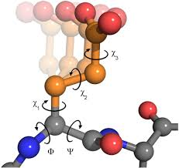
Degrees of freedom (DOF)
'' Partially Flexible ''
Flexible regions may be limited to local interface regions in this case we should insert :
Side chain DOF (rotamers)
or Local backbone DOF
Reminder: reduce inteligently the DOF and the
Conformational space in a way that you steel get good results in good time scale

Slide 3
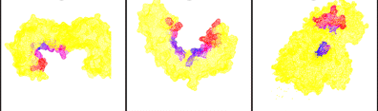
Conformational changes
When protein-protein goes upon conformational changes when binding accurs

Slide 4
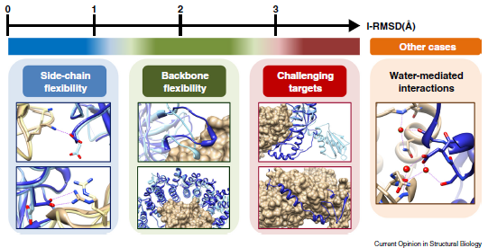
Conformational changes
To mesure the degree of conformational change is employed the I-RMSD (root mean square deviation) of interface residues when the
Unbound protein structure are superposed onto the bound protein-protein
complex
The I-RMSD also gives an idea of the chanlege that we are upon to when docking

Slide 5
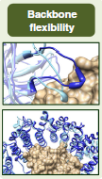
Conformational changes
''Few/moderate'' conformational changes
'Partially Flexible' docking
consider minimal flexibility (see previous slides)
it's a technic that brings an improvement of the results regarding rigid-body docking when conformationam change accompanied by binding is moderate.
Consideration of the back bone flexibility in partial flexible docking
How intra-molecular conformational changes occur by binding ?
Mainly 2 approaches are used :
Conformational selection model
Induced fit model

Slide 6

Conformational changes
Conformational selection model :
conformational state is meta-stable in the unbound state is stabilized by complex formation.
So we proceed by pré-sampling candidate conformers of each binder in the unbound state. We use this pré-sampled structures and run a rigid-body or partially flexible docking.

Slide 7
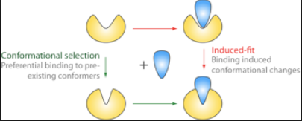
Conformational changes
Induced fit model :
Conformational changes are induced by specific intereactions with the binding partener
Computational docking has to to sample intra-molecular conformations 'on the fly' with inter molecular orientation wich is a very heavear approach
Incuced fit + conformational change models
A suggestion was made defending that we could consider that the overall
Conformational changes by binding occur via conformational selection , but
Additional changes follow to optimize specific interactions with the binding partener via induced fit

Slide 8
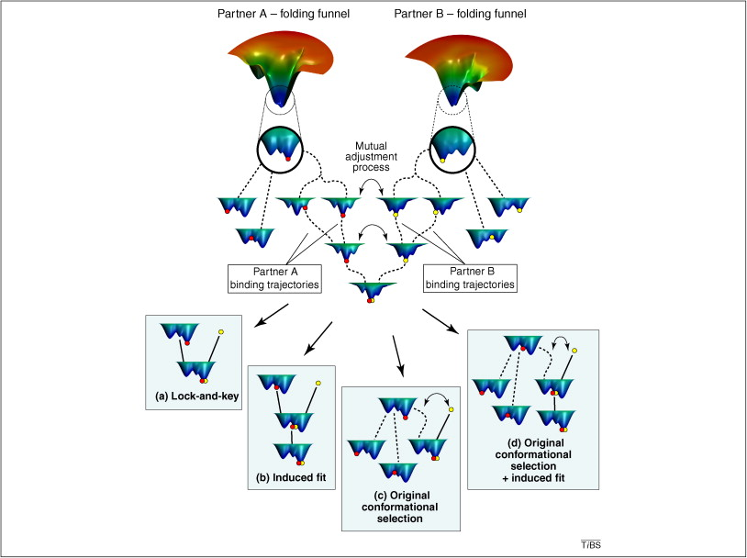

Slide 9
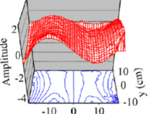
Conformational changes
In partially flexible docking only interface side-chain DOF are considered,
and backbone structures are fixed or relaxed during local minimization
including all backbone DOF would dramatically increase the complexity of
the problem.
If we have a structural change at the binding interface that propagates to other parts of
The structure changes in the hole structure have to be sampled.
An approach to this problem is dealing with motion along a limited number of low frequency normal modes* for each subunit
* A normal mode of an oscillating system is a pattern of motion in which all parts of the system move sinusoidally with the same frequency and with a fixed phase relation

Slide 10
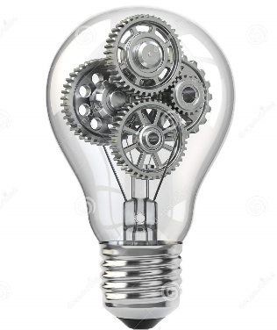
Conformational changes
Using this approach we should be able to capture with low-frequency normal modes
conformational changes accompanied by binding for each subunit
This idea was actualy applied to flexible docking algorithms by implementing sampling of normal mode DOF
Overall, normal mode methods tend to increase the chance of
successful docking for proteins involving moderate conformational changes

Slide 11
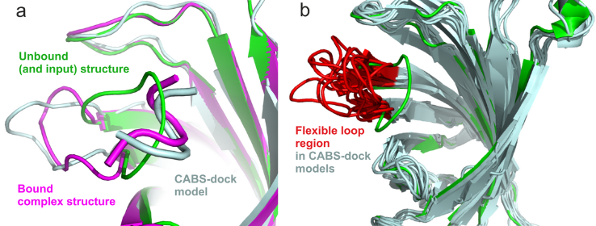
Conformational changes
When bind interfaces involve flexible loops or temini
Technic :
Determine a set of DOF that are going to describe flexible motion, pre-sample the conformations along those DOF using flexible docking before use of rigid body or partially flexible docking, or even by on the fly sampling of those DOF together with rigid-body DOF
Reminder : pre-information about regeons undergoing conformational changes in related structure/sequence proteins may be useful

Slide 12
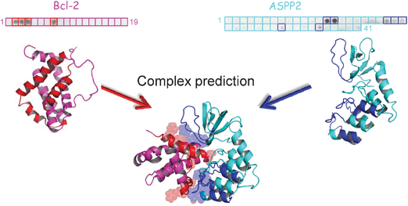
Conformational changes
Is very chalenging when conformational change is large
The border limitation of backbone-flexible docking is I-RMSD = 2-3 Argstrongs
Changes that are not properly described by either normal mode motion or
Localizated motion are hard to predict with current docking methods
In the extreme case we docking require simultaneous calculations of folding and docking
Large structural changes could be predicted by Molecular Dynamics simulation
But such long simulations may not be feasable for large complexes in the near future

Slide 13
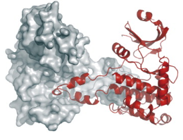
High resolution Protein-Protein Docking
High-resolution flexible docking methods employ atomistic molecular representation to sample atomic DOF contributing to molecular flexibility and to score flexible conformations
Problem:
Difficulty of sampling in the high-dimensional conformational space
High cost of scoring individual conformations
The exponential increase of local minima energy
Slow convergence of sampling algorithms due to high sensitivity to structural details

Slide 14
High resolution Protein-Protein Docking
Two strategies to overcome sampling difficulty that may not rely on previus/additional Information in ab initio high resolution docking are :
Chose relevant regions of conformational space (leading to less sampling)
Sampling by Effective global optimization

Slide 15
High resolution Protein-Protein Docking
Global optimization algoritms adopts a single trajectory in witch a single conformation serially evolvs in a iterative maner (normaly don't reach a global minimum energy)
Global optimization algoritms :
Monte Carlo Minimization (MCM)
Molecular Dynamics (MD)

Slide 16
High resolution Protein-Protein Docking
Monte Carlo Minimization (MCM)
Search in the space of local minima
It is also possible to make a global search by using probabilistic crossing of barriers comparable to the thermal energy
Should be run multiple times to find the global minimum energy
Remind
B = exp[-/\w/RT]
r = [0 ; 1]

Slide 17
Should we decouple or integrate sampling and scoring ?
Decoupling :
Simplifies computational problems
Simplifies methode development
Possibility of using decoy sets to improve score functions
Integrating :
Seams to give better results and a greater number of near-native conformations

Slide 18
Two ways to create a decoy set :
Perturbation
Docking (with bound and unbound proteins)
Perturbation based decoys :
Are created by slighly displacing their bound parts of a cocrystallized complex or by supperimposing the unbound (separatelly crystallized) proteins on their bound counterparts, in the complex, and then generating perturbation of the resulting structure.
Docking based decoys:
Are generated either by docking the unbound (separately crystallized) proteins, or by docking the two (bound) protein structures extracted from the complex

